Slide 1
Models and datasets

Slide 2
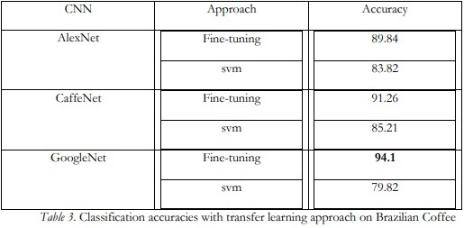
List of datasets along with accuracy

Slide 3
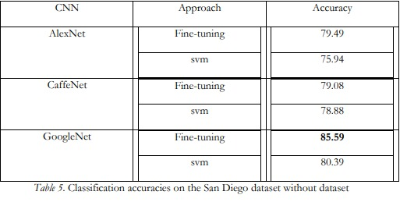
List of datasets along with accuracy

Slide 4
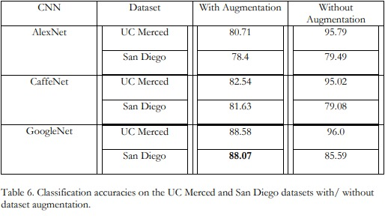
List of datasets along with accuracy

Slide 5
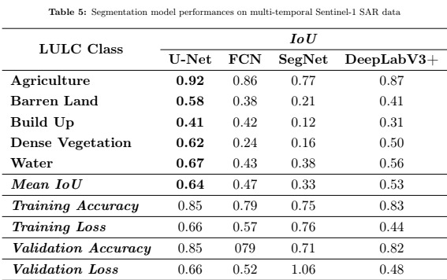
Sentinel 1 dataset

Slide 6
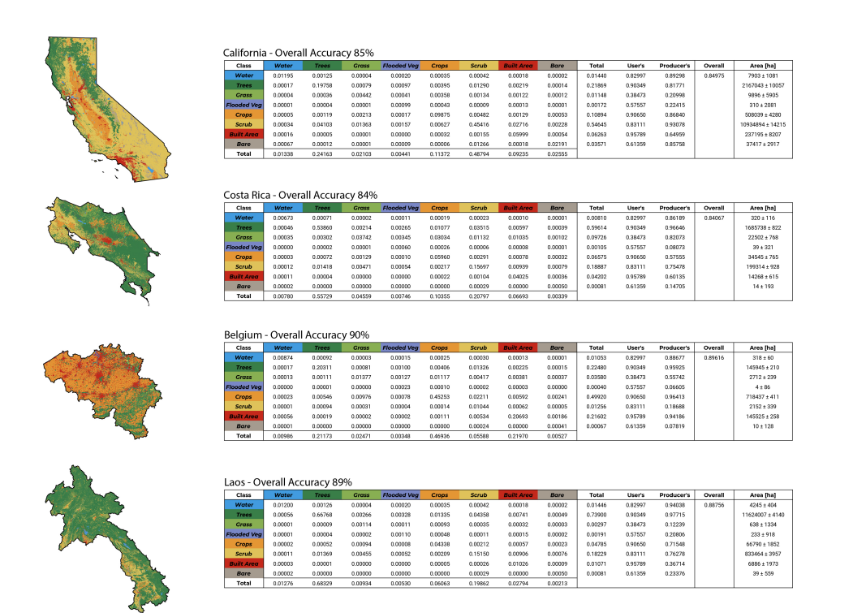
Sentinel 2 dataset using U-Net model

